Slide 1
Offshore Platform Sensor Less Monitoring
Problem type: Regression

Slide 2

Problem Statement
Monitoring Oil Extraction Platform in the Deep-Water Ocean is a complex and expensive task
Requires many key sensors that costs ranges from $50k to $1m for each, can lead to $20m to $25m Capital expenditure only for sensor just for 1 platform
If the sensor doesn’t work the monitoring of the components totally stops, which can lead to a catastrophe
Also from onshore it is impossible to monitor the platform that are far away from land
Operators seeking
A sensor less monitoring of platforms key components to cover the time when sensor isn’t working
Replace the costly sensors with virtual sensor that can save them $3m to $5m for each platform in deep ocean

Slide 3
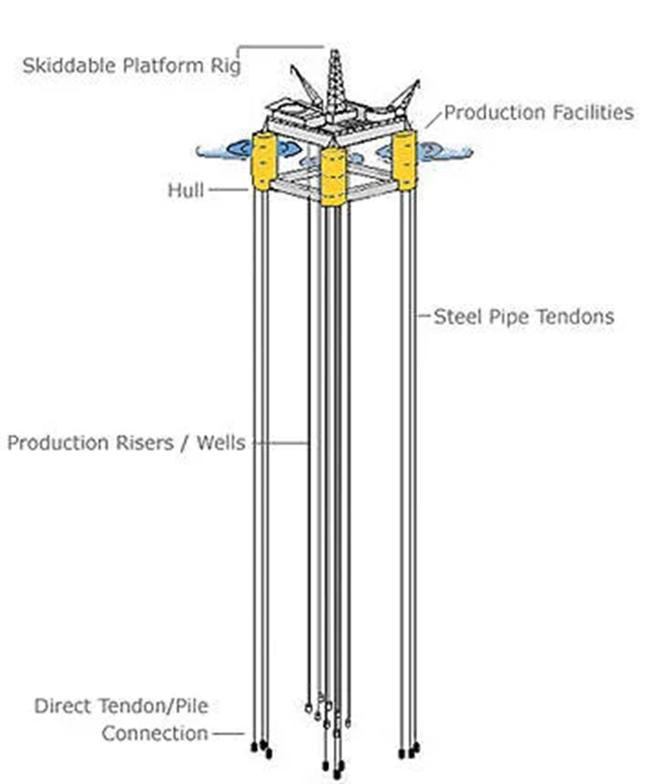
Offshore Tension Leg Platform (TLP)
Deep Water Platform Up to 3000 meter Tall
Floats in the water so pushes upward
Thick and High Diameter big and long Steel Pipe, called as Tendon, hold the TLP from drifting away
Create huge tension at the connection of TLP platform and the Tendon
To monitor tension in Tendon the operator puts sensors that cost around $750,000 each
Generally, there are minimum 16 Tendons, 4 at each side that can cost ranges $10m to $12m capital expenditure only to monitor TLP.
There is Operation cost too

Slide 4
Target: Predict Tendon Tension
Solution sought
Target
Tendon Tension Prediction
The operation manager needs to know,
Continuous prediction of Tendon Tension
Should be able to monitor without sensor
Platform Motion
Met-Ocean
Event Record
Tendon Specs
Age
Diameter
thickness
Material
Position
Velocity
Acceleration
Wind
Wave
Time of Failure
Error type

Slide 5
Tendon Model Test Position Time Series
The Training Data Obtained through prototype testing in the laboratory. The lab prototype mimics the TLP’s Deepwater behavior.
Met Ocean(16 extra variables)
Wind Speed
Wind Direction
Wave Condition
Operation history
6 DoF Position, Surge, Sway, Heave, Pitch, Roll Yaw
Failure Event:
None Available
Machine Specification
None

Slide 6

So lets Run with a Robot AI…..

Slide 7
Get the Virtual Sensor in 4 steps
Name Project “Industrial”and Solution Name “Off_Platfrm_TLP”→ Regression → Click create project
Data
Heave_V | (df["Heave"].shift(-1)-df["Heave"].shift(1))/(2*((df["Time"].shift(-1) - df["Time"])))
Surge_V | (df["Surge"].shift(-1)-df["Surge"].shift(1))/(2*((df["Time"].shift(-1) - df["Time"])))
Sway_V | (df["Sway"].shift(-1)-df["Sway"].shift(1))/(2*((df["Time"].shift(-1) - df["Time"])))
Pitch_V | (df["Pitch"].shift(-1)-df["Pitch"].shift(1))/(2*((df["Time"].shift(-1) - df["Time"])))
Roll_V | (df["Roll"].shift(-1)-df["Roll"].shift(1))/(2*((df["Time"].shift(-1) - df["Time"])))
Yaw_V | (df["Yaw"].shift(-1)-df["Yaw"].shift(1))/(2*((df["Time"].shift(-1) - df["Time"])))
Surge_A | (df["Surge"].shift(-1) - (2*df["Surge"]) + df["Surge"].shift(1))/(((df["Time"].shift(-1) - df["Time"]))**2)
Sway_A | (df["Sway"].shift(-1) - (2*df["Sway"]) + df["Sway"].shift(1))/(((df["Time"].shift(-1) - df["Time"]))**2)
Heave_A | (df["Heave"].shift(-1) - (2*df["Heave"]) + df["Heave"].shift(1))/(((df["Time"].shift(-1) - df["Time"]))**2)
Pitch_A | (df["Pitch"].shift(-1) - (2*df["Pitch"]) + df["Pitch"].shift(1))/(((df["Time"].shift(-1) - df["Time"]))**2)
Roll_A | (df["Roll"].shift(-1) - (2*df["Roll"]) + df["Roll"].shift(1))/(((df["Time"].shift(-1) - df["Time"]))**2)
Yaw_A | (df["Yaw"].shift(-1) - (2*df["Yaw"]) + df["Yaw"].shift(1))/(((df["Time"].shift(-1) - df["Time"]))**2)
Name your data “Platform Simulation” → upload Offshore_Platform_.csv
Select target. Choose “Tension” as your target
A window will pop up asking you run the preliminary analysis or not. Press Yes Button
Preliminary analysis will run-→see result in Confusion Matrix and Prediction KPI for error
Press Next→ land in “build Model page
Build Model
Select Variables
Select Unselect Variable and Try to Impove
Select Algorithm
Linear Regression
Random Forest
XGBoost
Click on Train
Click on Finalize
You will land on Deploy page

Slide 8
Get the Virtual Sensor in 4 steps
Deploy
Decision
Click on Add data→
upload new data from CSV source from you computer Offshore_Platform_Tendon_Tension.csv file
Create Equation for decision making
Go to Result Configuration
Check download as CSV
Select Algorithm
Random forest or other
Press “Predict”, prediction will running
Press Next→ you will land in Decision Page
Select Decision Scenario Tab
Change slider value for different variables
Press Apply
Do the step until Target or Target desired value is higher or lower or middle
Alert_LR | ["Severe Station Keeping" if x > 775 else "Station Keeping" if x > 700 else "Safe Operation" for x in df["Tendon Tension_LR"]]

Slide 9


